Slide 1
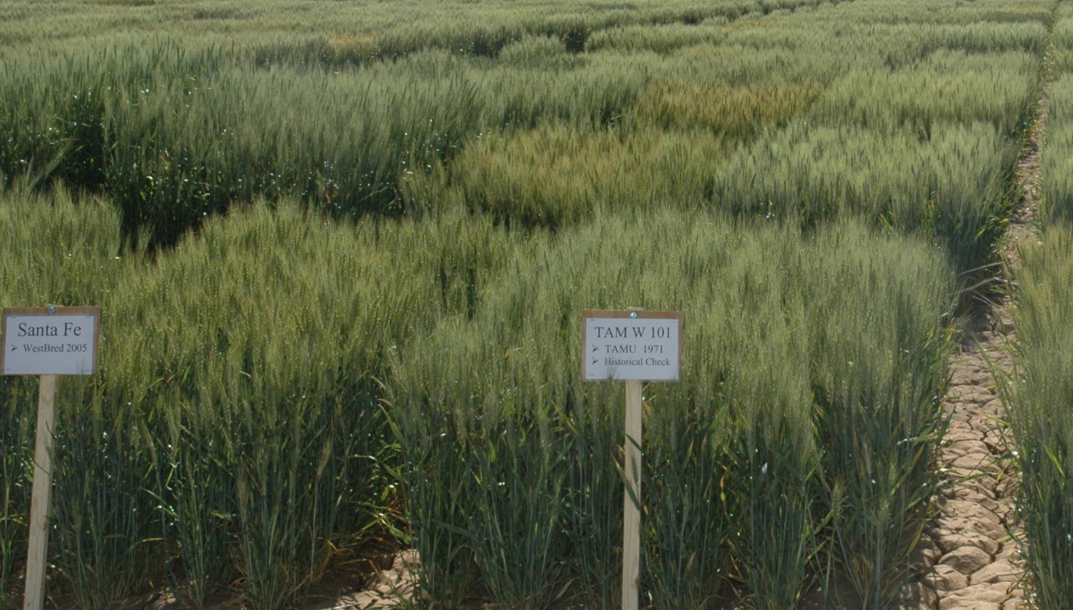
CRSS (PBGG) 8010:
Research Methods and Design in Crop Science
Jason Wallace Fall 2026
Lecture 12
Factorial Designs
Kay Ledbetter

Slide 2
Lecture outline
Administrative stuff
Review of last time
Factors
Factorial designs
Interactions

Slide 3
Administrative stuff
Midterm 1 starts immediately after class
  No class Tuesday; due next Thursday at class start
  Open-book and open-Internet, just not open-classmate.
    (and don’t use AI to answer the questions)
  Can edit the Word document and turn that in; no need for a separate R notebook.
    Works best if put answers in different color

Slide 4
Review:
Randomized Complete Block Design
Download ‘12_maize.csv’ and run an ANOVA analysis on it
  If the varieties are significant, also determine which variety/varieties to recommend to farmers
    (We usually don’t care about block-to-block differences)

Slide 5
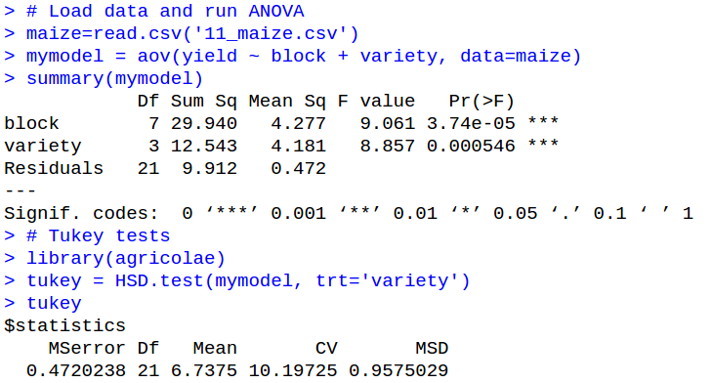
Review:
Randomized Complete Block Design
Significant

Slide 6
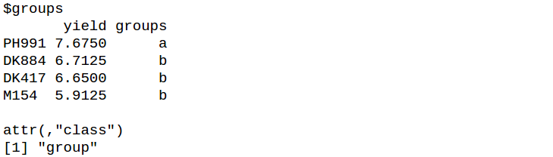
Review:
Randomized Complete Block Design
…
Best variety

Slide 7
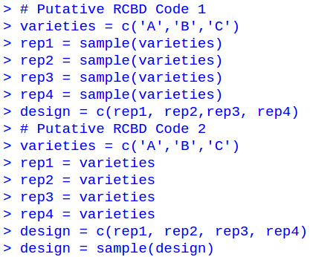
Review:
Randomized Complete Block Design
Which of the following code will generate a RCBD?

Slide 8
Review:
Randomized Complete Block Design
Which of the following code will generate a RCBD?
RCBD
CRD

Slide 9
Questions on RCBD?

Slide 10


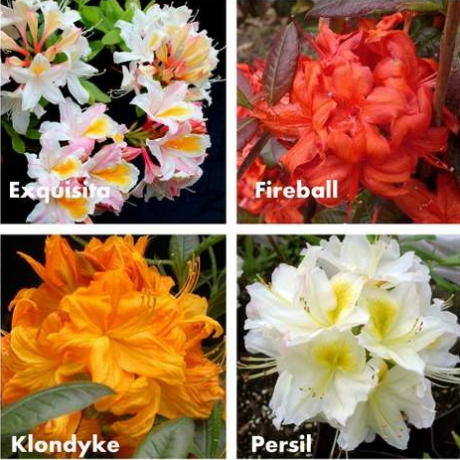
What is a factor?
Factors are categorical variables that can take a few discrete values
ClearChoicesCleanWater.org
glendoick.com
Fruit Color
Fertilizer Types
Plant Variety

Slide 11
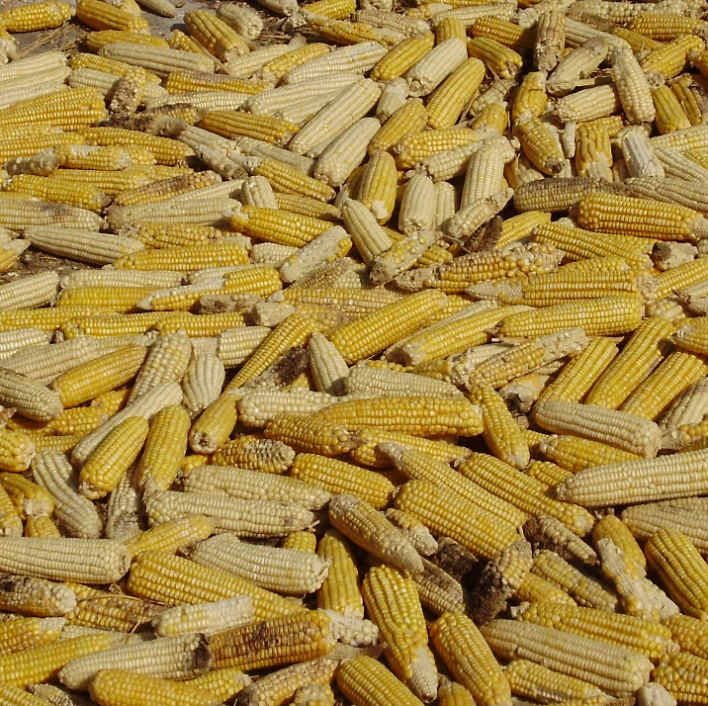
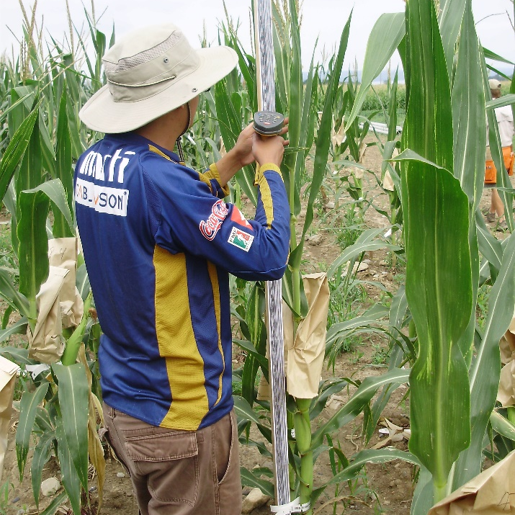
Factors versus continuous variables
In contrast, continuous variables can take a wide range of values
Yield
Plant Height

Slide 12








Continuous variables as factors
We sometimes group a continuous variable into a few bins to turn it into a factor for convenience
Plant Height
Short
Medium
Tall

Slide 13
Factors in R
Factor “Variety”
Because factors are so common in statistics, R has a special data type to deal with them
Factors consist of two parts:
  The levels of the factor (a character vector)
  The values given for each level (an integer vector)
Levels
“Abel”
“Monty”
“Zylph”
Values
1
2
2
1
3

Slide 14
Explicit factors are less common now
In older versions of R (before 4.0), columns of text were loaded as factors by default
Now the default is characters but they get converted to factors when we do analyses (ANOVA, linear regression, etc.)

Slide 15

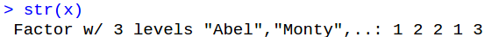
Factors in R (cont.)
When you print out a factor, R usually gives you the corresponding labels
Indication that this is a factor, not a character vector
str() lets you see the integers under the hood
Vector of levels

Slide 16
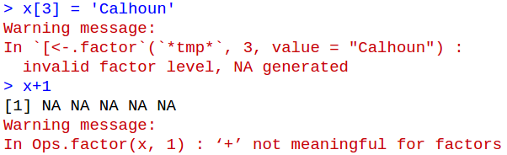
R is picky about factors
You need to keep your factors straight because trying to treat them as either a character or an integer can cause problems
Try to set an invalid level
Try to use in addition

Slide 17
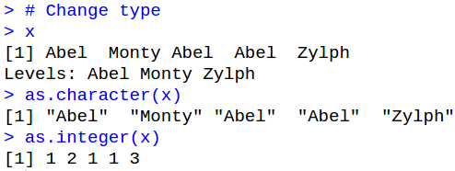
Changing vector types
If you need it in a different form, you can change with the as._____() family of functions
Convert to character
Convert to integer
Notes:
There are corresponding as.numeric(), as.logical, as.matrix(), as.data.frame(), etc. functions. (Some require additional arguments, such as the dimensions for a matrix)

Slide 18
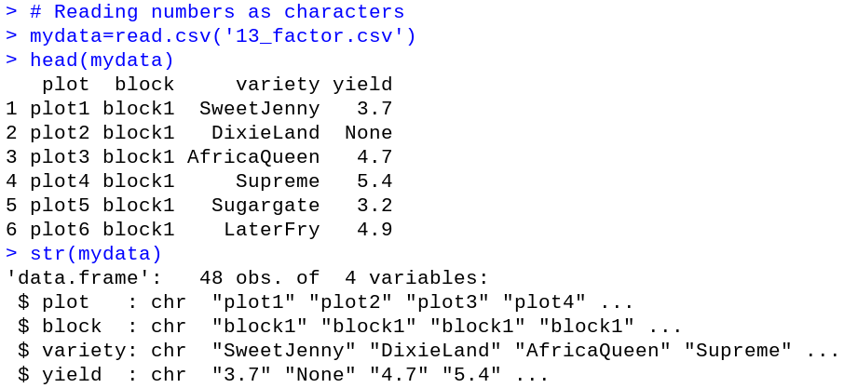
Frequent error: numbers as characters
Sometimes due to a typo a vector will be read as a factor instead of numeric
Same data as in review, but with “None” entered as one yield
Notes:
R will accept “NA” and “NaN” as valid missing scores and read them correctly, but it doesn’t know what to do with “None” and so reads the entire column as strings, which (by default) are turned into factors

Slide 19
Frequent error: numbers as characters
Again, str() shows us what’s really going on
Not what we want
Notes:
R will accelt “NA” and “NaN” as valid missing scores and read them correctly, but it doesn’t know what to do with “None” and so reads the entire column as strings, which (by default) are turned into factors

Slide 20
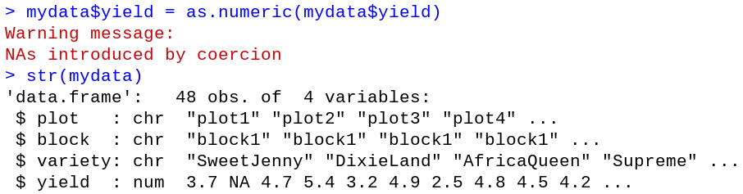
Frequent error: numbers as characters
Can be fixed with as.numeric()
Warning because can’t convert “None” to a number
Now actually numbers
Notes:
R will accelt “NA” and “NaN” as valid missing scores and read them correctly, but it doesn’t know what to do with “None” and so reads the entire column as strings, which (by default) are turned into factors

Slide 21
In-class exercise:
Making factors
Without using R, write down how this data would appear as a factor:
RoseColor
Cream
Orange
Red
Orange
White
Cream
Orange

Slide 22
In-class exercise:
Making factors
RoseColor
RoseColor
Cream
Orange
Red
Orange
White
Cream
Orange
Levels
Cream
Orange
Red
White
Values
1
2
3
2
4
1
2
Notes:
Note: By default, R orders factor levels alphabetically, but you can change this behavior if you really want to. (I have rarely if ever seen this to be necessary, however).

Slide 23

What is a factorial design?
"No aphorism is more frequently repeated in connection with field trials, than that we must ask Nature few questions, or, ideally, one question, at a time. The writer is convinced that this view is wholly mistaken.“
- R. A. Fisher
“Factorial” = Testing two or more factors at once
  Specifically, testing them and their interaction

Slide 24
Goal of factorial designs
The primary goal of factorial designs is to do more with less
Example: Tall fescue response to N or P fertilizer:
Test Nitrogen
RCBD with 4 reps
Test Phosphorus
RCBD with 4 reps
0
20
50
0
5
10
20
0
50
0
10
5
50
20
0
10
5
0
0
50
20
5
0
10

Slide 25
Goal of factorial designs
0
20
50
Total observations | 12
Block DOF | 3
Treatment DOF | 2
Error DOF | 6
Nitrogen
20
0
50
50
20
0
0
50
20
0
5
10
Total observations | 12
Block DOF | 3
Treatment DOF | 2
Error DOF | 6
Phosphorus
0
10
5
10
5
0
5
0
10

Slide 26
Combining experiments
Now watch what happens if we combine them:
0/5
0/0
50/0
50/10
20/5
20/10
20/0
50/5
0/10
Nitrogen + Phosphorus
RCBD with 4 reps
50/5
0/5
20/0
20/5
0/10
50/10
50/0
0/0
20/10
20/0
0/5
20/10
0/0
20/5
50/5
50/0
0/10
50/10
50/10
20/10
20/0
20/5
0/10
50/0
0/0
50/5
0/5
Total observations | 36
Block DOF | 3
Nitrogen DOF | 2
Phosphorus DOF | 2
Error DOF | 28

Slide 27
Doing more with less
Compare the power of these setups
Total observations | 12
Block DOF | 3
Treatment DOF | 2
Error DOF | 6
Total observations | 36
Block DOF | 3
Nitrogen DOF | 2
Phosphorus DOF | 2
Error DOF | 28
Total observations | 12
Block DOF | 3
Treatment DOF | 2
Error DOF | 6

Slide 28
Doing more with less
Compare the power of these setups
Total observations | 12
Block DOF | 3
Treatment DOF | 2
Error DOF | 6
Total observations | 36
Block DOF | 3
Nitrogen DOF | 2
Phosphorus DOF | 2
Error DOF | 28
Total observations | 12
Block DOF | 3
Treatment DOF | 2
Error DOF | 6
50% more samples

Slide 29
Doing more with less
Compare the power of these setups
Total observations | 12
Block DOF | 3
Treatment DOF | 2
Error DOF | 6
Total observations | 36
Block DOF | 3
Nitrogen DOF | 2
Phosphorus DOF | 2
Error DOF | 28
Total observations | 12
Block DOF | 3
Treatment DOF | 2
Error DOF | 6
50% more samples
>450% DOF for error

Slide 30
Hidden replication
In addition to error DOF, we also get more reps of individual treatment levels
0/5
0/0
50/0
50/10
20/5
20/10
20/0
50/5
0/10
50/5
0/5
20/0
20/5
0/10
50/10
50/0
0/0
20/10
20/0
0/5
20/10
0/0
20/5
50/5
50/0
0/10
50/10
50/10
20/10
20/0
20/5
0/10
50/0
0/0
50/5
0/5
4 reps of each combination
However, these extra reps are only “free” if the factors don’t interact
12 reps of each individual factor level

Slide 31
What are factorial designs?
Factorial designs are any design where you’re testing more than one important factor at once
  Contrast this with unimportant or “nuisance” factors, like blocks in RCBD
Factorial designs are actually a superset of designs, since any of the other designs we study can be made into a factorial design
  Factorial CRD, Factorial RCBD, Factorial Latin Squares, etc.

Slide 32
Factorial designs fall into two camps
“Full factorial designs” use every possible combination of factors
  Most basic designs fall here
“Fractional factorial designs” use only a subset of possible combinations
  Confounded designs (later in the semester) are the best example of this

Slide 33
Treatments in full factorial designs
The “treatment” in a full factorial design is the combination of factors, not the individual factors themselves
5 rhizobia inoculations
15 total treatments
3 Varieties of peanut
A
B
C
=
A
B
C
x
A
B
C
A
B
C
A
B
C
A
B
C
Notes:
Rhizobia are inoculated to help with nitrogen fixation.
Note that no randomization has been done yet.

Slide 34
Quick exercise:
Treatments in full factorial designs
How many treatments does each of the following experiments contain?
Experiment 1:
4 corn varieties
6 fertilizers
Experiment 2:
3 blueberry types
3 pesticides
3 fertilizer mixes
Experiment 3:
7 switchgrass varieties
4 tillage schemes
3 irrigation schemes
5 fertilizers
3 pesticides
2 harvest points

Slide 35
Quick exercise:
Treatments in full factorial designs
How many treatments does each of the following experiments contain?
Experiment 1:
4 corn varieties
6 fertilizers
Experiment 2:
3 blueberry types
3 pesticides
3 fertilizer mixes
Experiment 3:
7 switchgrass varieties
4 tillage schemes
3 irrigation schemes
5 fertilizers
3 pesticides
2 harvest points
24 Treatments
27 Treatments
Don’t do this
2520 Treatments

Slide 36
Full factorials get big quickly
Since you have to include every possible combination, the number of treatments rises very fast
When doing a full factorial, you have to limit yourself to a reasonable number of treatments
  This is one of the full factorial’s chief limitations
  This is also why fractional factorial designs are useful

Slide 37
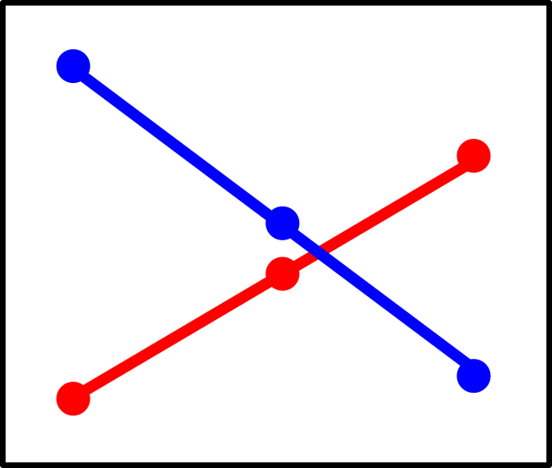
Testing interactions
One reason people like factorials is because they let you test interactions between factors
An interaction means that the combination of A and B does something different than either does separately

Slide 38
Interaction example
Say we have the following yield results:
  50 kg/ha nitrogen = +200 kg yield
  20 kg/ha phosphorus = +100 kg yield
Test with 50 kg/ nitrogen + 20 kg/ha phosphorus
No interaction
Interaction
Application | Yield
N | +200
P | +100
N + P | +300
Application | Yield
N | +200
P | +100
N + P | +450
The effect of both together is different than just adding separately

Slide 39
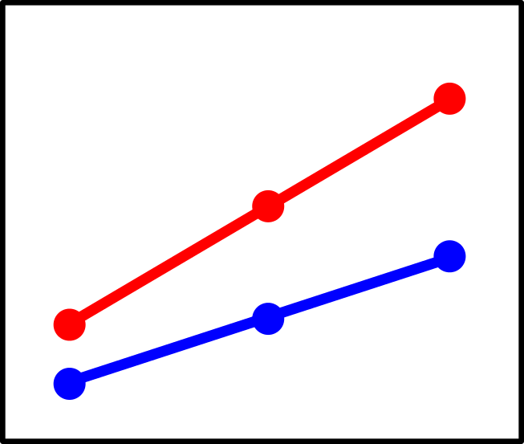
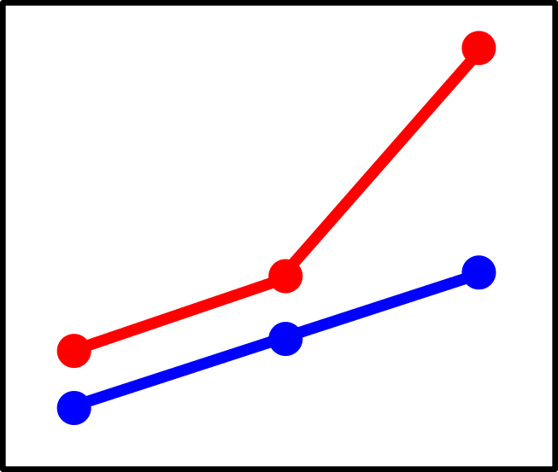
Three general types of interactions
Change in magnitude
Change in Ranking
Change in slope
Variety A
Variety B
Nitrogen levels
Notes:
If there were no interaction, the lines would be completely parallel

Slide 40
Statistical terminology:
Simple versus main versus interaction effects
Simple effect = effect of factor A at one level of factor B
  Effect of additional P at N=20
Main effect = effect of factor A across all levels of factor B
  Effect of additional P at any level of N
Interaction effect = effect of factor A and B together independent of their main effects
  Effect of A+B at any level of A and B

Slide 41
Properties of interactions
Interactions are symmetric:
  If A interacts with B, then B interacts with A
  Cannot have a one-way interaction
Test of significance is completely independent of the test for main effects
Strong interaction effect
Minimal/zero main effects

Slide 42
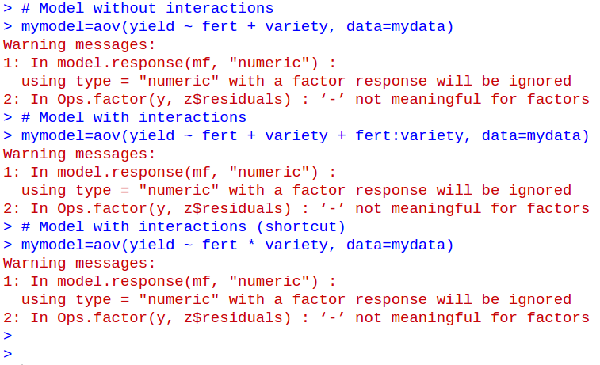
Testing interactions in R
Interactions are specified in R with a “:” between model terms
Interaction term

Slide 43
Shortcut for interactions in R
As a shortcut, you can use “*” in a model formula to mean “all main effects and their interactions”
Equivalent
Notes:
Many times I’ll still write it out the long way just to make it absolutely clear what it is I want to test

Slide 44
In-class exercise:
Basic factorial analysis
Download “12_cotton.csv”, which is a factorial CRD comparing cover crops and fertilizer combinations on cotton.
Run an ANOVA on this data looking at both main effects and their interaction. Which is/are significant?

Slide 45
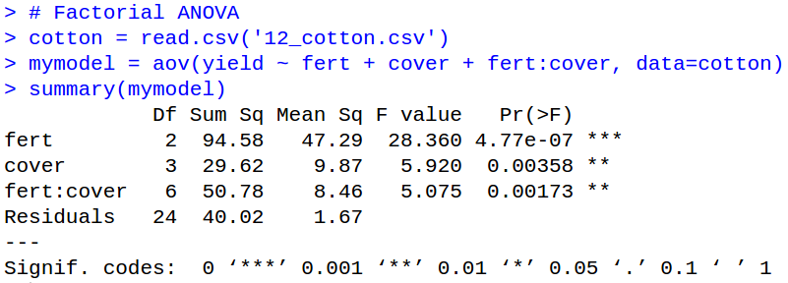
In-class exercise:
Basic factorial analysis
All effects are significant

Slide 46
In-class exercise:
RCBD factorial analysis
Now run a similar analysis for the data in ‘12_alfalfa.csv’, which is a RCBD
  Testing several alfalfa varieties against 2 rhizobia inoculations
  Make sure to include the block effect
  Blocks shouldn’t interact with anything

Slide 47
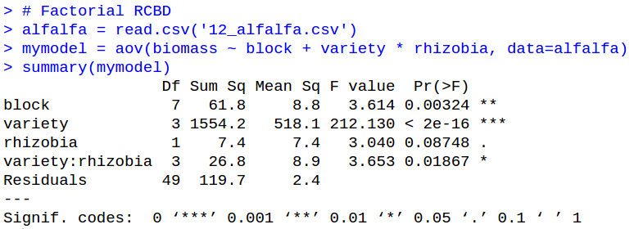
In-class exercise:
RCBD factorial analysis
Block, variety, and interaction significant
Main effect of rhizobia is not

Slide 48
Questions on factorial analysis?

Slide 49
Statistical versus biological interaction
ANOVA interaction effects are statistical interactions
These only reflect the mathematical behavior of factor A versus factor B
Whether there is biology involved is another question entirely

Slide 50
Statistical versus biological interaction
Wheat A does better in Environment 1 (hot & dry)
Wheat B does better in Environment 2 (cool & wet)
Strong statistical interaction
Several potential reasons:
  Different water use efficiency
  Different disease resistance
  Different insect resistance
  Different nutrient requirements
  Different lodging propensity
Interactions can lead you to form hypotheses, but you usually need more data or a new experiment to test them

Slide 51
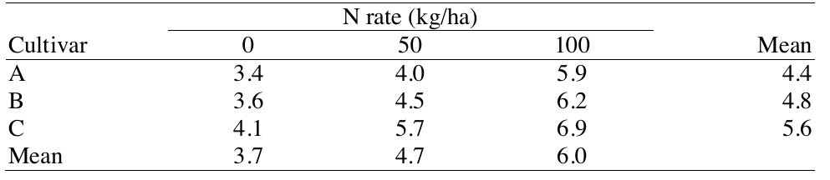
Statistical versus practical significance
Interactions can render the main effect meaningless
  But that doesn’t mean they always do so
Based on Agronomy 771 notes, U Wisconsin

Slide 52
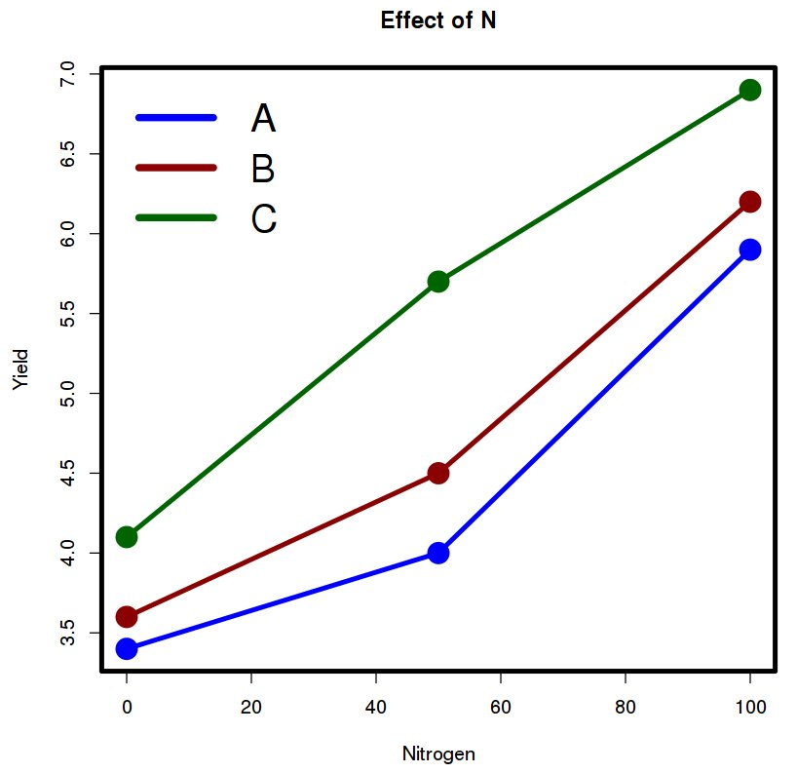
Statistical versus practical significance
The interaction effect here is statistically significant.
  Does it make a difference in practice?
If you were a farmer, which would you grow?
Based on Agronomy 771 notes, U Wisconsin

Slide 53
Specifying your factorial design
As mentioned “factorial” (or even “full factorial”) is only part of the design
The other part is how you arrange the treatments

Slide 54
Types of full factorial: Unreplicated CRD
The most basic full factorial is an unreplicated one in CRD
3 peanuts x 5 rhizobia = 15 treatments
A
B
C
A
B
C
A
B
C
A
B
C
A
B
C

Slide 55
Types of full factorial: Unreplicated CRD
The most basic full factorial is an unreplicated one in CRD
3 peanuts x 5 rhizobia = 15 treatments
C
B
A
All treatments present
Everything randomized in a single block
C
A
C
B
B
A
C
B
A
B
C
A

Slide 56
Types of full factorial: Unreplicated CRD
The most basic full factorial is an unreplicated one in CRD
3 peanuts x 5 rhizobia = 15 treatments
C
B
A
Fill out the DOF
Term | DOF
Variety
Rhizobia
V x R interaction
Error
Total:
C
A
C
B
B
A
C
B
A
B
C
A

Slide 57
Types of full factorial: Unreplicated CRD
The most basic full factorial is an unreplicated one in CRD
3 peanuts x 5 rhizobia = 15 treatments
C
B
A
Fill out the DOF
Term | DOF
Variety | 2
Rhizobia | 4
V x R interaction | 8
Error | 0
Total: | 14
C
A
C
B
B
A
C
B
A
B
C
A

Slide 58
Types of full factorial: Unreplicated CRD
The most basic full factorial is an unreplicated one in CRD
3 peanuts x 5 rhizobia = 15 treatments
C
B
A
Fill out the DOF
Term | DOF
Variety | 2
Rhizobia | 4
V x R interaction | 8
Error | 0
Total: | 14
You can only test interactions if they’re replicated
C
A
C
B
B
A
C
B
A
B
C
A

Slide 59
Types of full factorial: Unreplicated CRD
The most basic full factorial is an unreplicated one in CRD
3 peanuts x 5 rhizobia = 15 treatments
C
B
A
Fill out the DOF
Term | DOF
Variety | 2
Rhizobia | 4
V x R interaction | 8
Error | 8
Total: | 14
C
A
C
B
B
A
C
B
A
B
C
A
Notes:
Drop the interactions because are unreplicated

Slide 60
Types of full factorial: Replicated CRD
Next step up is to replicate it so you can test interaction effects
Same experiment, but now with 3 reps
  3 varieties, 5 rhizobia, 3 reps in CRD
Term | DOF
Variety
Rhizobia
V x R interaction
Error
Total:
C
B
A
C
A
B
C
B
A
C
C
B
A
A
C
A
A
C
B
A
C
B
A
A
C
B
A
C
B
A
C
B
A
C
B
A
B
C
A
B
C
B
B
C
B

Slide 61
Types of full factorial: Replicated CRD
Next step up is to replicate it so you can test interaction effects
Same experiment, but now with 3 reps
  3 varieties, 5 rhizobia, 3 reps in CRD
Term | DOF
Variety | 2
Rhizobia | 4
V x R interaction | 8
Error | 31
Total: | 44
C
B
A
C
A
B
C
B
A
C
C
B
A
A
C
A
A
C
B
A
C
B
A
A
C
B
A
C
B
A
C
B
A
C
B
A
B
C
A
B
C
B
B
C
B

Slide 62
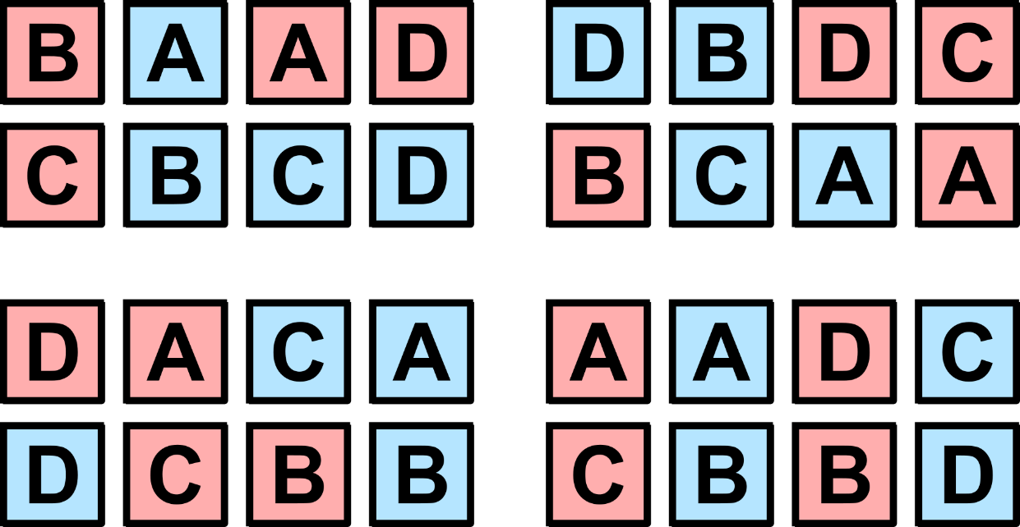
Types of full factorial: Replicated RCBD
(Slightly) more complex is a full factorial in RCBD
Different experiment this time:
  4 corn varieties
  2 clover intercrops
  4 reps in RCBD
Term | DOF
Block
Maize
Clover
M x C interaction
Error
Total:
Notes:
Note: you can’t have an _unreplicated_ RCBD. A RCBD with only 1 block is just a CRD without replication.

Slide 63
Types of full factorial: Replicated RCBD
(Slightly) more complex is a full factorial in RCBD
Different experiment this time:
  4 corn varieties
  2 clover intercrops
  4 reps in RCBD
Term | DOF
Block | 3
Maize | 3
Clover | 1
M x C interaction | 3
Error | 21
Total: | 31
Notes:
Note: you can’t have an _unreplicated_ RCBD. A RCBD with only 1 block is just a CRD without replication.

Slide 64
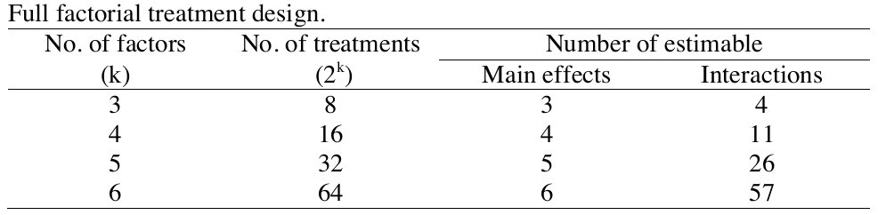
Limits on factorial design
The biggest limits on factorial designs are practical
The number of interactions increases exponentially with the number of factors
(2 levels per factor)
Based on Agronomy 771 notes, U Wisconsin

Slide 65
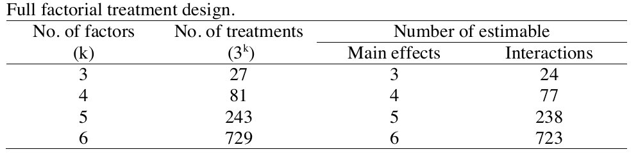
Limits on factorial design
The biggest limits on factorial designs are practical
The number of interactions increases exponentially with the number of factors
(3 levels per factor)
Based on Agronomy 771 notes, U Wisconsin

Slide 66
Questions on factorial designs?

Slide 67
Reminder for Midterm 1
Begins immediately after class, ends immediately before class next week (=1:15 PM on Oct 1st)
Put your answers in the midterm file itself to upload. (No need for a separate R notebook)

